Slide 1
Instant word power

Slide 2
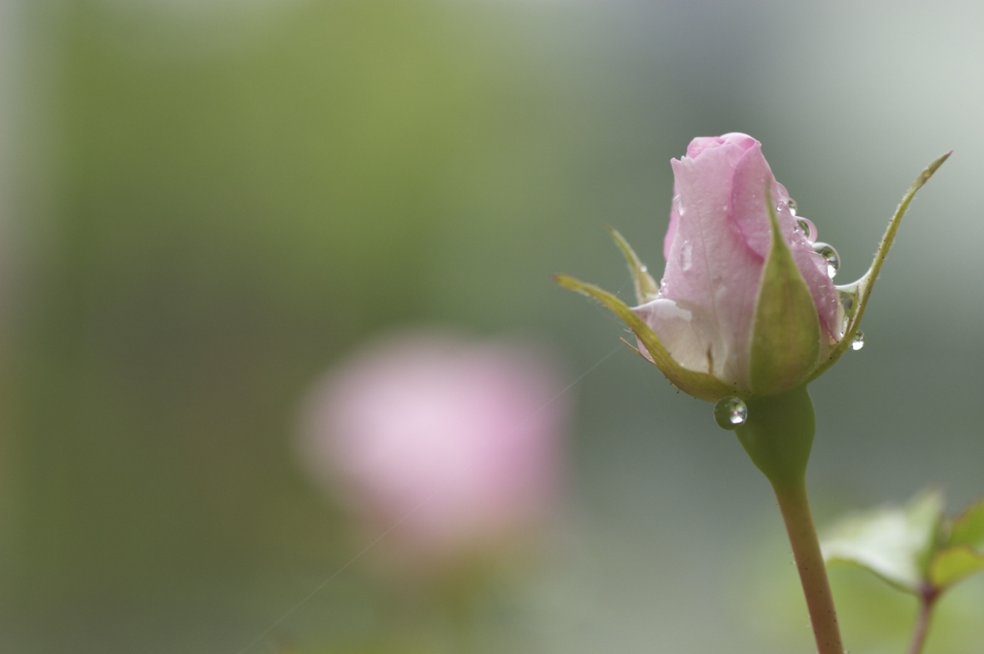

Slide 3
Associations

Slide 4
Warn -

Slide 5
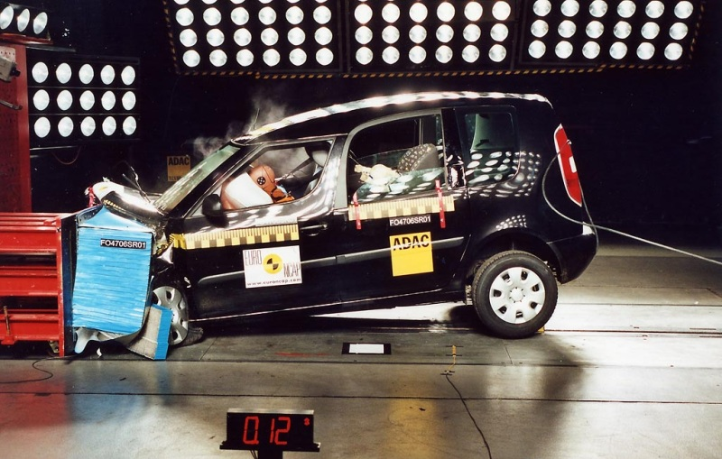
crash

Slide 6
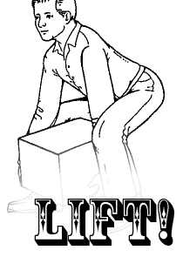

Slide 8
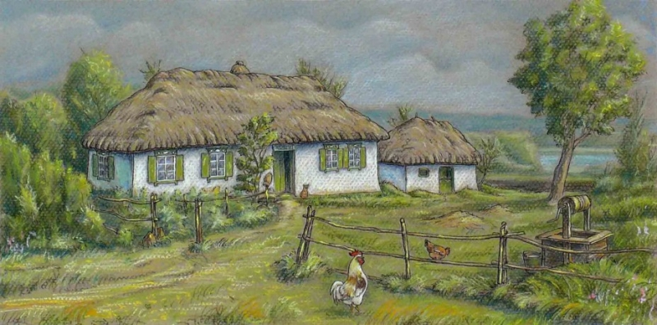
hut

Slide 9
International words

Slide 10
Mathymatics History Russian Literature Chemistry Physical Culture Biology Geography Information technology
SCHOOL SUBJECTS

Slide 11
Teacher
Учитель
Student
Студент

Slide 12
Let’s try to speak!
love/study/teach
I love/study/teach
I love/teach/study English/Literature
I love to teach/study English

Slide 13
SIGNS AROUND US

Slide 14
Практикум по этимологии
Корни - ped , cycle
Приставки – 2 - bi, 4- quadro
Press it with your foot. ____________
Walker___________
Statue stands on it.___________
Two feet.__________________
Four feet.__________________
Two wheels.___________________
Two focuses.__________________
Every two month.________________
quadruped bifocal
pedal biped
bicycle pedestrian
pedestal bimonthly

Slide 15
Social networking and gadjet settings
Change the world around you!
Make a shift!!!

Slide 16
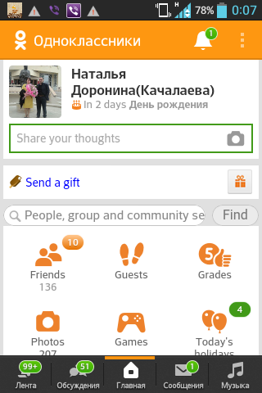

Slide 17
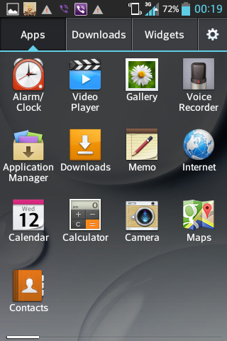

Slide 18
WE WILL ROCK YOU!

