Slide 2
1. Predicting the topic of the lesson
Watching the video

Slide 3
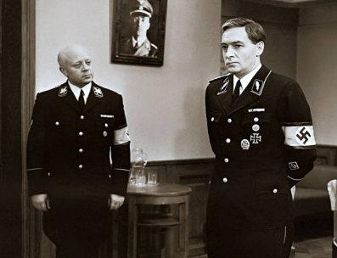
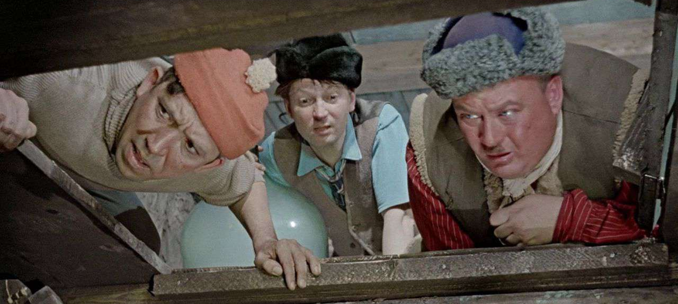
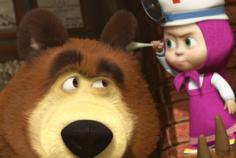
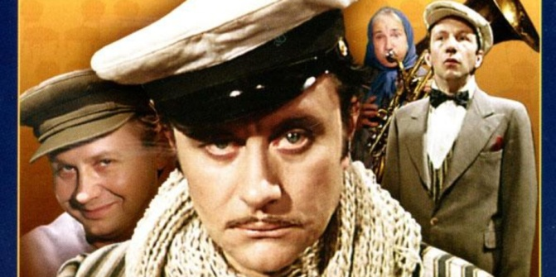
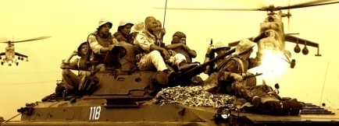
Cinematography
in Russia

Slide 4
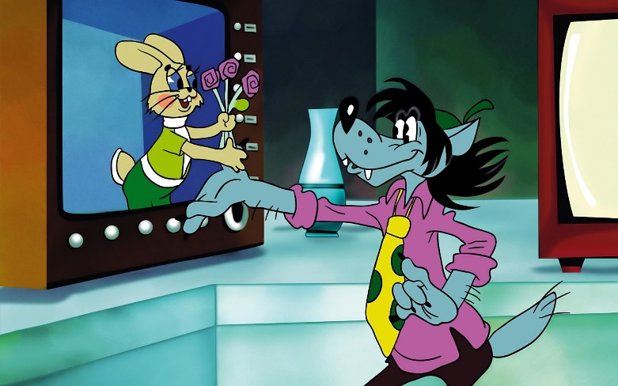
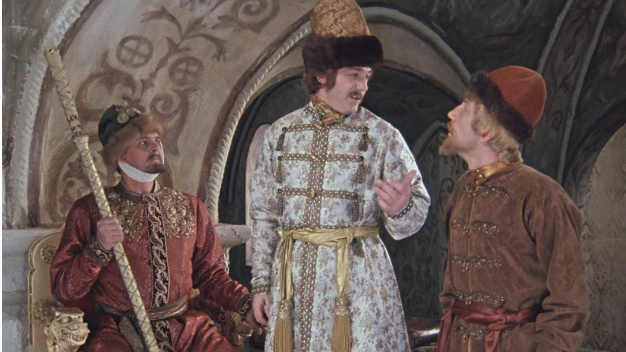
Educational purposes:
improvement of lexical and writing skills;
the development of creative abilities and esthetic taste of pupils;
the development of universal educational actions;
the development of communicative abilities.

Slide 5
2. Checking homework. Brainstorming.
corporations
genre
Hollywood
films
film making process

Slide 6
3. Reading (3 min)
Read the text and decide if the statement is true, false or unstated.
 | True/False/Unstated
The Lumiere brothers’ film was the first step into the development of Russian cinematography | True
The first sound films simultaneously appeared in the USSR, the UK and Germany | False
The film “The battleship “Potemkin” was the first colour film | Unstated
“The Stone flower” won the 1961 Award for Best Film | False
More than 12 films are produced every year | False

Slide 7
4. Post-reading activity. Word-building
Who makes a film? Form the nouns that mean film-making professions.
The cast
Verb | Noun (person)
act | actor
produce | producer
direct | director
write | writer
operate | operator
photograph | photographer
animate | animator
compose | composer

Slide 8
THE PEOPLE WHO MAKE A MOTION PICTURE
Producer - продюсер, режиссер
Screenwriter - сценарист
Director - директор
Unit Production Manager –ассистент режиссера
Casting Director - ассистент по подбору актеров
Actors - актеры
Stunt People - дублеры
Animal “Actors” – животные-актеры
Film and Sound Director - звукорежиссер
Designers - дизайнеры, оформители
Camera operators - операторы

Slide 9
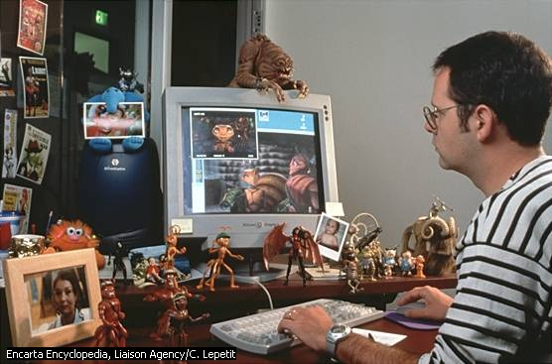
The Animator at Work

Slide 10
5. Exercising your eyes
1) Close and open your eyes (3 times).
2) Look left. Look right. (3 times).
3) Look up. Look down. (3 times).
4) Draw figure 8 with your eyes.

Slide 11
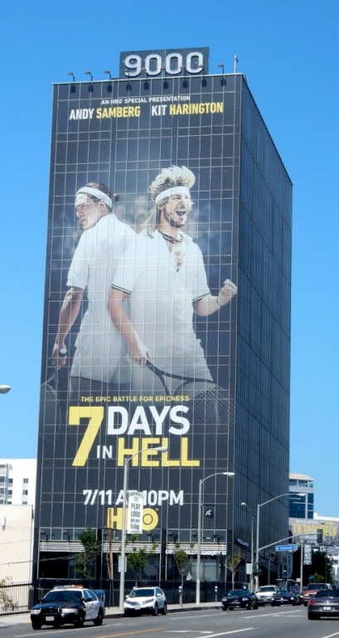
6. Project work
Imagine you have made your own film…
Make a poster to advertise your film.
Use pictures and pen-felts (маркеры).
Don’t forget to write about:
the genre
the director
The price of the ticket
The date/time of the premier

Slide 12
6. Project work
1. The film is about…
2. … stars in this film.
3. The roles are played by…
4. The scene is set in…
5. The ticket costs…
6. The genre of the film is…
7. Why should it to be watched?

Slide 13
7. Self-evaluation
Student’s name _____________________
Now I can | Level reached
 | poor | fair | good | excellent
Talk about types of films
Express preferences
Understand information about films
Write a poster
Write a film review
Understand genres of films
My mark is _________________________

Slide 14
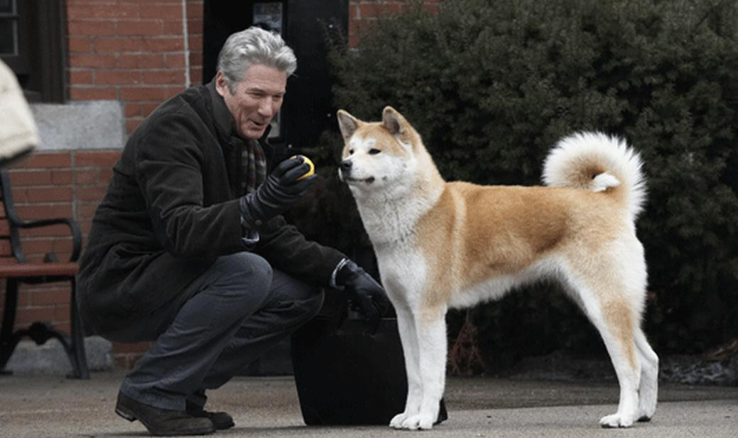
8. Homework
Watch the film “Hachico” and write an essay about the dog’s devotion
(100-140 words)

